Slide 1

Developing Culturally Attuned Interventions to Support Caregiving in Cancer
October 16, 2024
Ranak Trivedi, PhD, FSBM, FGSA
MED 275
Associate Professor, Department of Psychiatry and Behavioral Sciences, Stanford University
Director of Education and Training, Center for Innovation to Implementation, VA Palo Alto
Director of Caregiving and Family Systems, Stanford CARE

Slide 2
No financial conflicts of interest to disclose.

Slide 3

Comet Tsuchinshan–ATLAS
October 15, 7:52 pm

Slide 4
What is the annual cost of unpaid (family) caregiving of adults in the United States?
$600 Billion

Slide 5



$600,000,000,000
$555.7 B
$529.95 B

Slide 6
Framily
Friends or family members in the network of individuals with medical or mental health conditions
Caregivers
Framily who provide direct support to individuals with medical or mental health conditions

Slide 7
Who are caregivers?
Family members and friends who support those with illnesses
Terminology varies: “informal caregivers”, “Family caregivers”, “Carers”, ”CarePartners”, or “Care Partners”
In USA, 1 in 5 people are caregivers
2/3 of all caregivers are women
96% care for a family member
Caregiving practices are embedded in culture

Slide 8

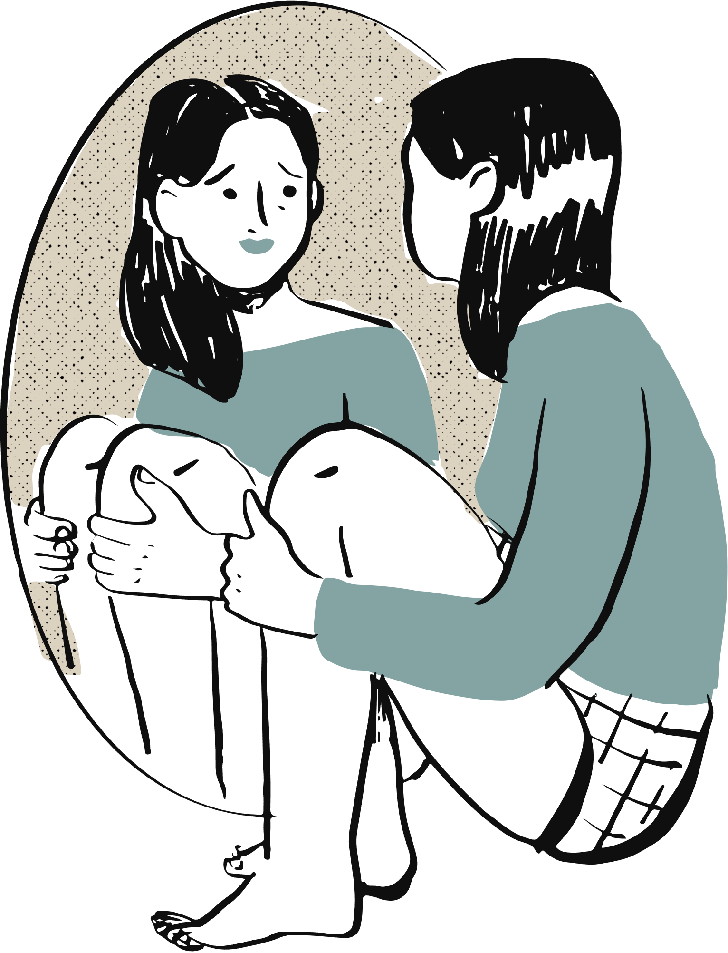
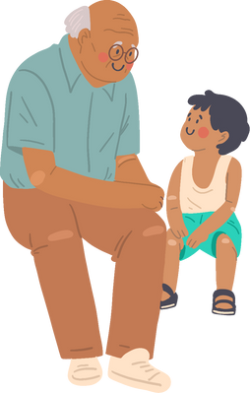

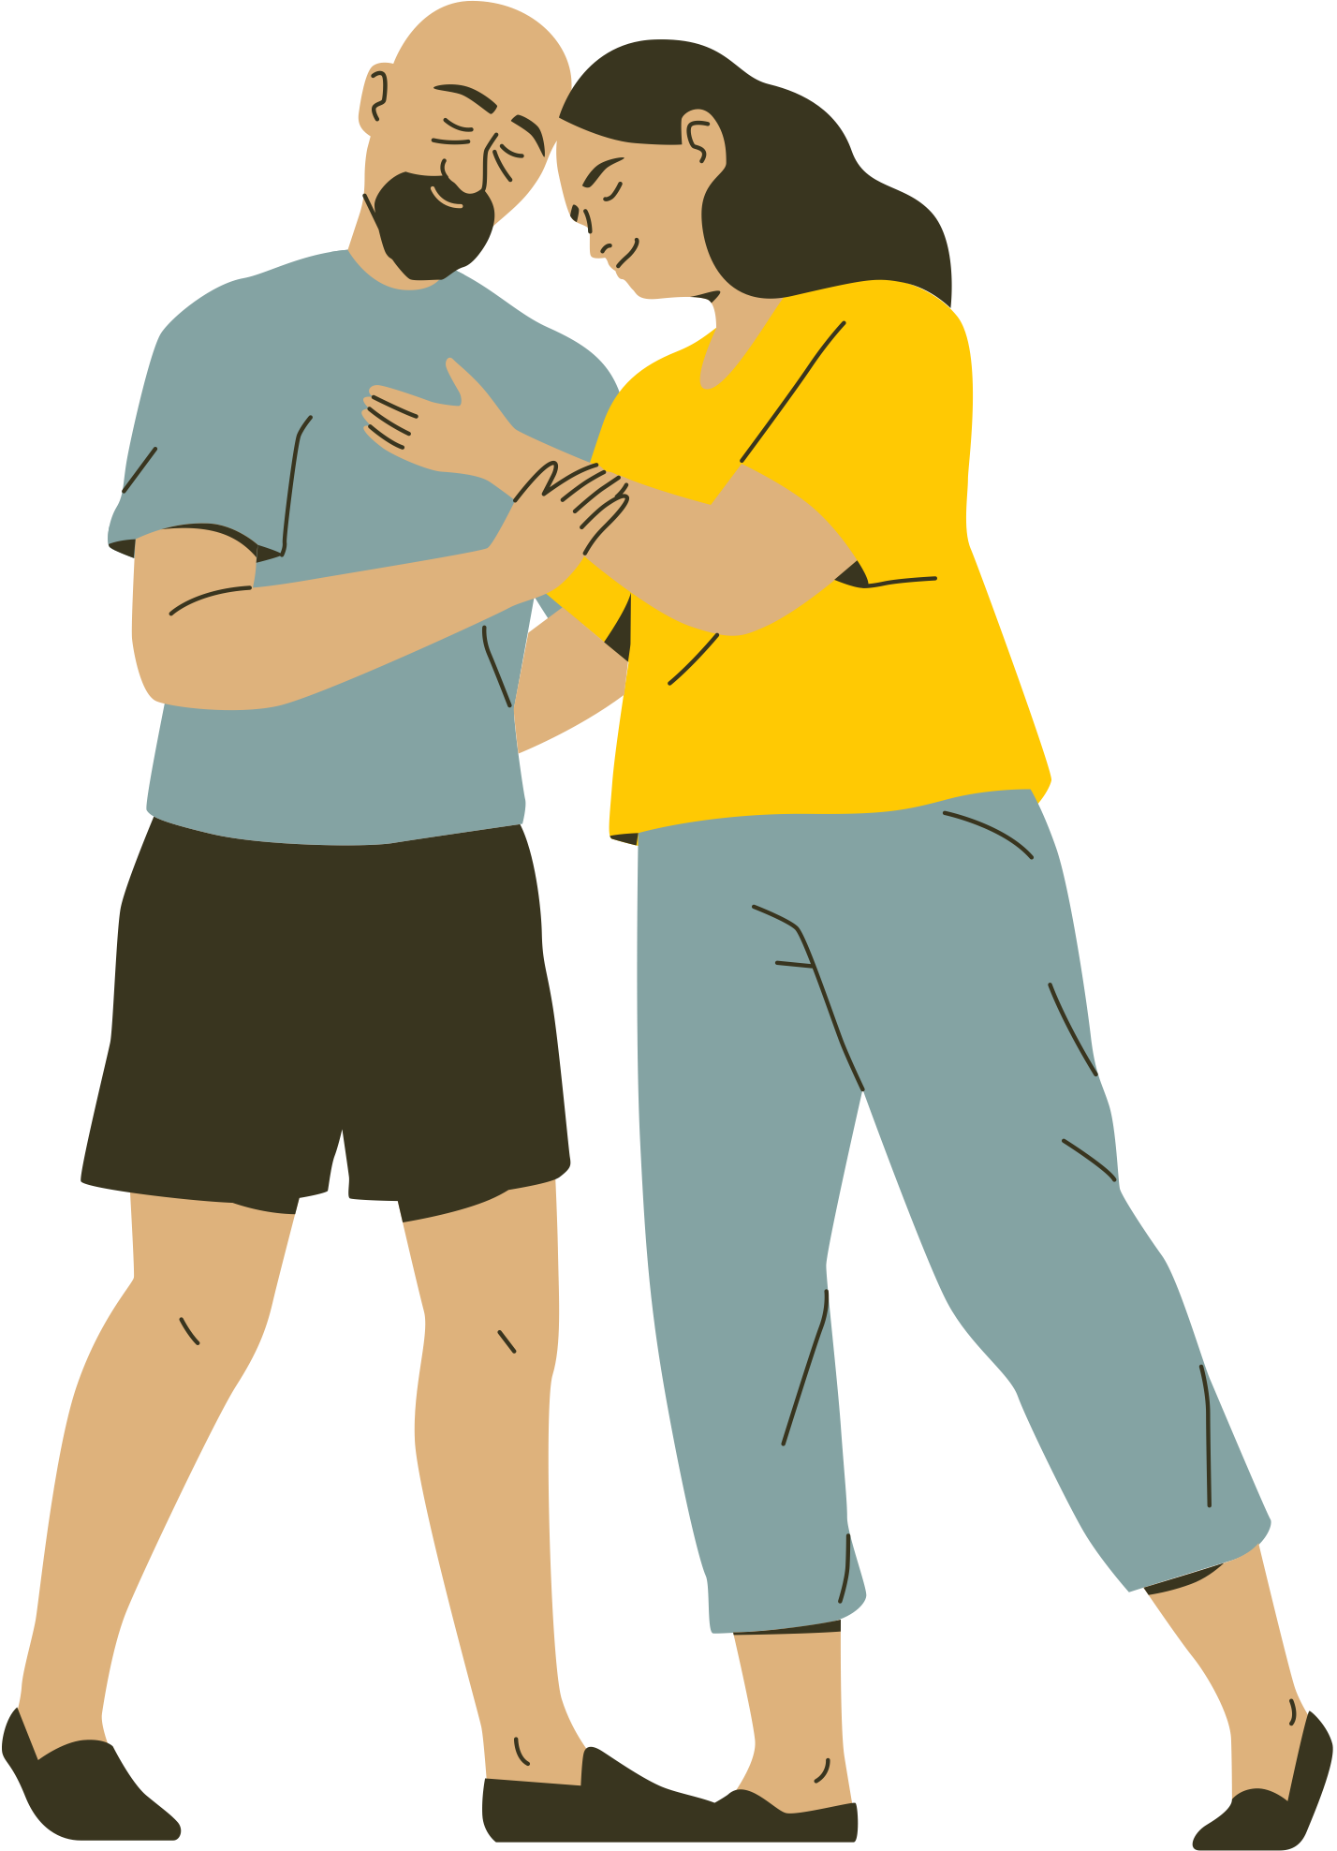


Caregiving Brings Joy...
83%
Notes:
Significant others experience more caregiving joy than other relations
Sources of positive effects:
Rewards of helping someone in need
Growth in roles and responsibilities
Benefit-finding
More time with a loved one
Meaning and purpose
Role modeling for the next generation

Slide 9
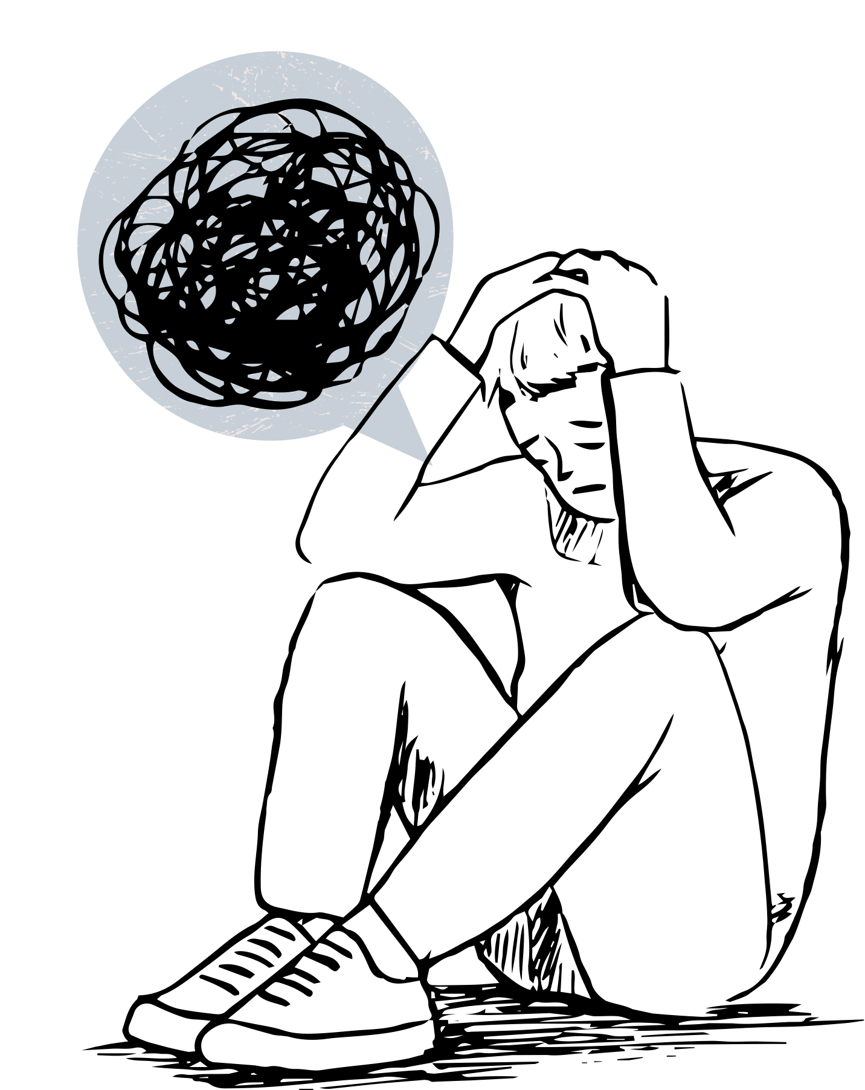
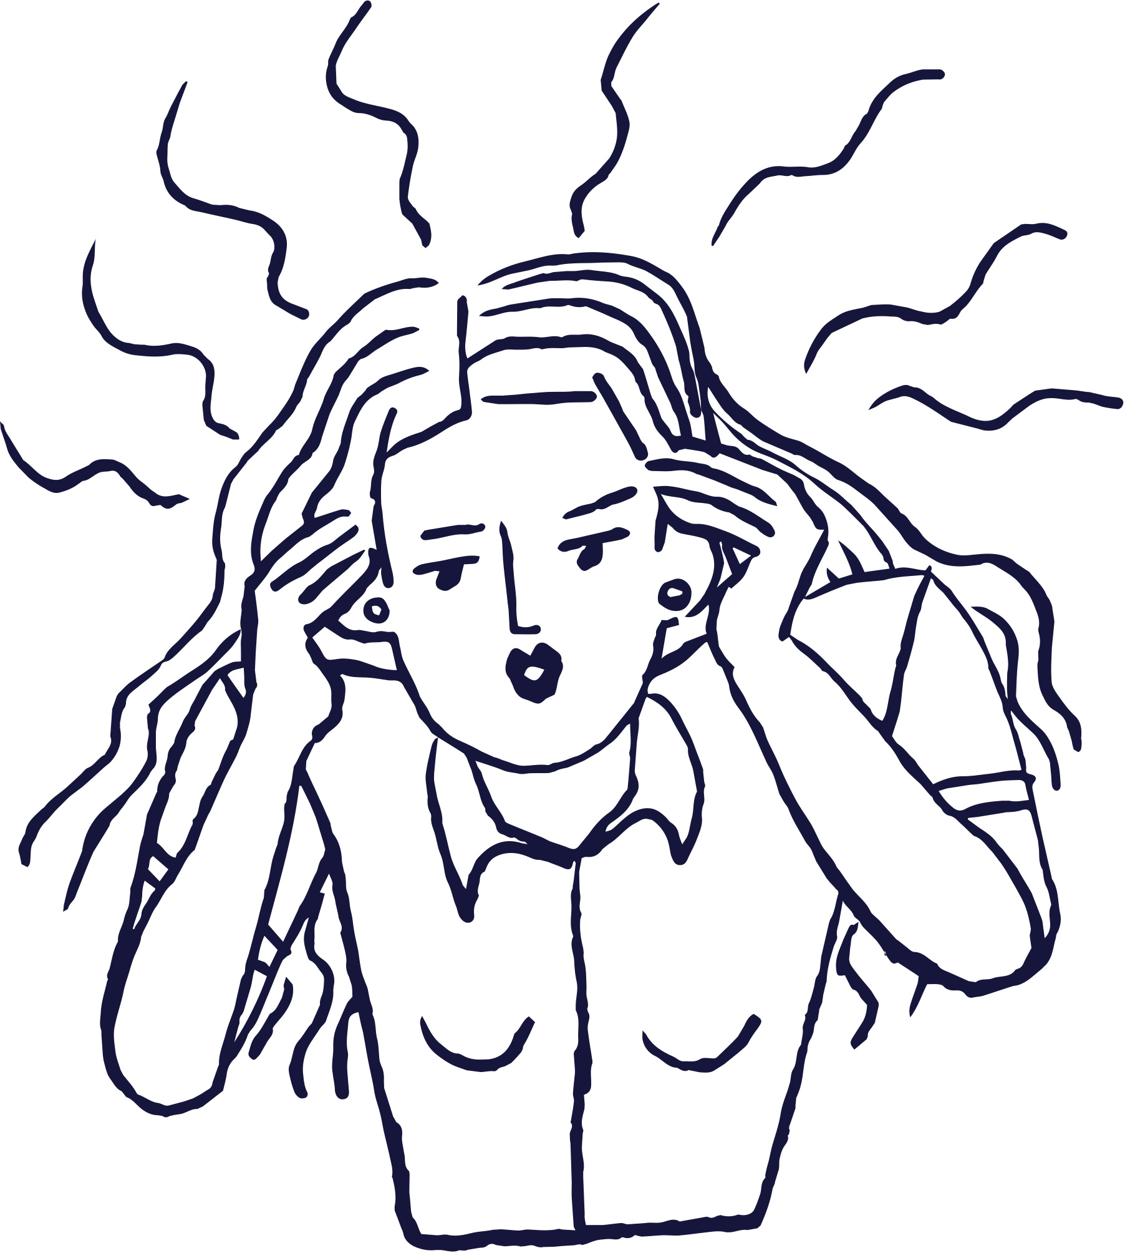

...But Has Negative Effects
Notes:
But caregiving also brings high levels of stress, depression, and caregiver burden. There are many reasons for this. First, more intense caregiving such as helping someone with toileting leads to more stress. Second, higher number of hours spent caregiving leads to more stress. Third, caregivers are often juggling other responsibilities such as caring for children, jobs. There are also system level burdens we place on our caregivers. We do not have federal policies that support time off for caregiving. We also have a health care system that ignores the contributions of caregivers. We and other researchers have shown that caregivers feel invisible and ignored by the care teams and want to be better engaged.

Slide 10
Cancer Caregiving
Cancer caregiving has received significant attention
2.8 to 6.1 M cancer caregivers in the US (2015)*
Provide ~32.9 hours/week
1/3 provide more than 41 hours
Yet, their needs are unmet
>50% experience being overwhelmed
<1/3 have discussed needs with providers
*Cancer Collaborative/NAC are updating these statistics

Slide 11

Cancer Self-management
There is a growing focus on self-management in cancer survivorship
Emotional support
Instrumental support (e.g., picking up medications, ADLs)
Complex medical tasks (e.g., wound care)
Adherence to diet and nutrition
Adherence to exercise recommendations
Preventive care (e.g., vaccinations)
Family caregivers may be responsible for self-management

Slide 12
Yet, caregivers are not empowered in healthcare.

Slide 13
Barriers to Empowering Caregivers
Culture
(e.g., language barriers)
Systemic
(e.g., policy, clinic time)
Interpersonal
(e.g., relationships)
Individual
(e.g., time, burden)

Slide 14



Cultural Barriers
Caregiving is culturally embedded
Gender roles
Motivation: duty, filial piety, affection
Intergenerational vs. peer support
Individual vs. collectivist
Language barriers
Stigmatized conditions can add burden
Religious beliefs can contradict evidence-based approaches
Culture

Slide 15
Compared to White Americans, racial/ethnic minorities in the US:
Provide more hours and more intense care
Experience worse physical outcomes
Have a wider network of family and friends who help
Compared to White caregivers
African American caregivers report less caregiving distress
Hispanic caregivers report caregiving adds purpose and meaning
Asian caregivers felt they had no choice
Compared to heterosexual individuals, those who identify as LGBTQ+ obtain more peer vs. intergenerational care

Slide 16

SAFAD

Slide 17
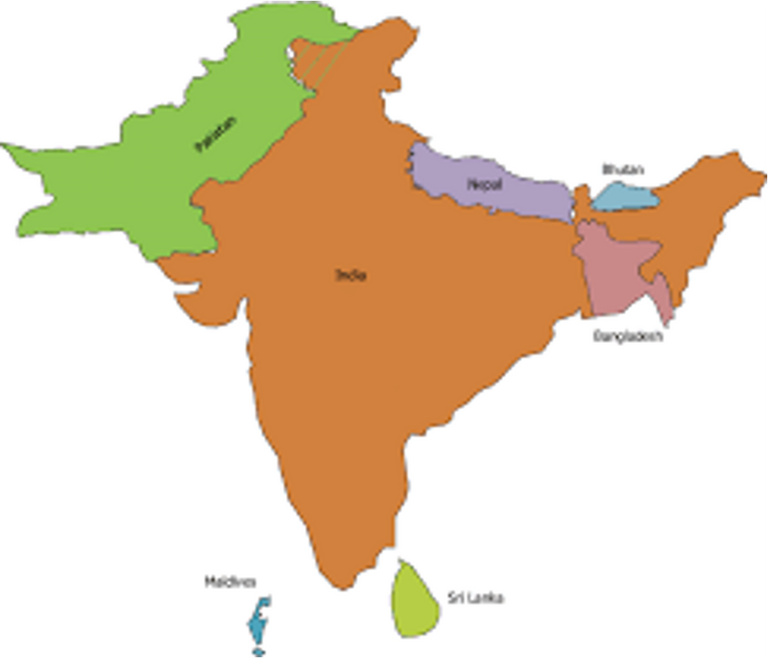

South Asians and Breast Cancer
1 in 5 people globally have a South Asian heritage
5.4 million in the US
Breast cancer rates increasing 1.9% annually among South Asians
Breast cancer management is affected by culture:
Taboo: 46%- sexual taboos inhibited breast cancer awareness
Stigma: No words for cancer or survivor
Collectivism: Community needs> Individual needs
Culture of service (“seva”)
Gender Roles: 80% caregiving is provided by women
Healthcare system is not designed to handle this cultural context

Slide 18
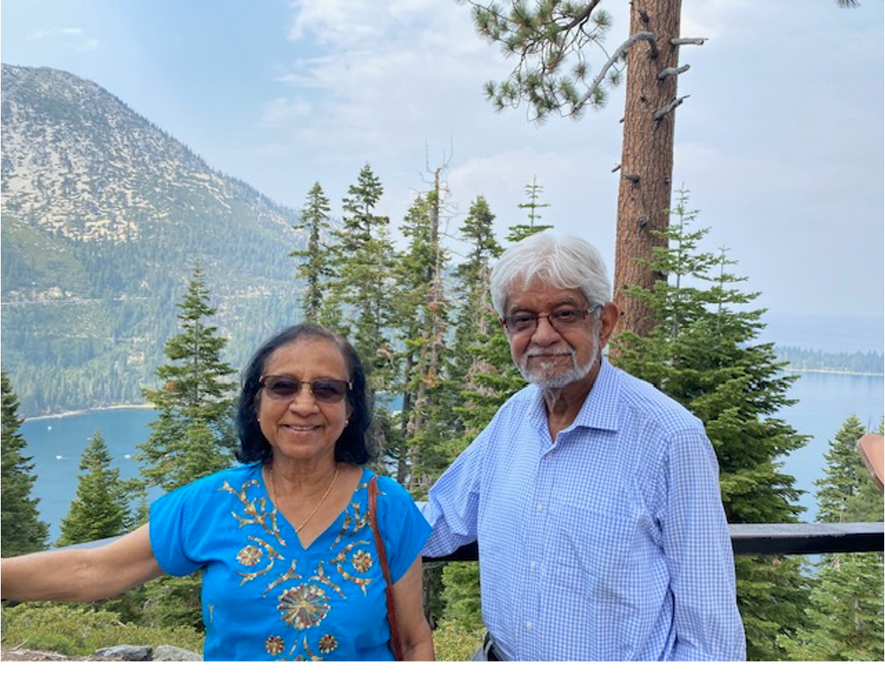

Slide 19
Dyadic Health Behavior Change Model
Patient
Stress
Depression
Self-efficacy
Social Support
Functional Limitations
Stress Coping
Self-management Stress Management
Depressive Symptoms
Medication Adherence
Symptom Management
Diet
Exercise
Biomarkers
Quality of life
Hospitalizations
Mortality
Cost
Caregiver
Stress
Depression
Self-efficacy
Caregiver Burden
Social Support
Stress Coping
Relationship
Dyadic Coping
Communication
Reciprocity
Collaboration
(Trivedi et al 2016)

Slide 20
Generative Co-Design Framework for Healthcare Innovation

Slide 21
I went almost silent in terms of not even talking about it because my wife was trying to brave it out (FCG, 47, Male)
I mean, I was terrified, actually… No one's going to come in with a cape and save the day. Like, this is real life. I could really die (BCS, 51)
I guess cancer is it's never out of your mind. I think you can never go back to being the carefree person that you were. (BCS, 39)
You feel emptiness, loneliness (BCS, 52)
Promise, don’t tell your mom because then my mom will find out, (BCS, 50)
I remember my mom reading [diet recommendations] and was, like, oh, I don't even eat half these things…this is very American food. This is not the foods that we eat (FCG, 22, Female)
It’s a chain reaction of going home, not having friends, and feeling lonely (FCG, 22, Female)

Slide 22
Generative Co-Design Framework for Healthcare Innovation

Slide 23
Opportunities for Collaboration
Co-design process to adapt web-SUCCEED to SAFAD
Web-SUCCEED: ongoing RCT
Secondary analyses from mixed methods SAFAD data
Secondary data analyses with large national dataset of high need, high risk Veterans and caregivers

Slide 24
Summary
Family caregivers can play important roles in managing the health of those with cancer
Empowering caregivers will require changes at all levels
Theoretically derived, culturally attuned interventions are needed to support diverse caregivers
Dyadic interventions may be necessary to support the survivor-caregiver dyads

Slide 25

“When you ignore caregivers, you leave half the team on the bench.”
–Susannah Fox, former CTO of HHS

Slide 26
Acknowledgments
Funding | Mentees | Team
VA HSR&D CDA CHF QUERI VA HSR&D Pilot Grant Ci2i LIP VA HSR&D IIR VA HSR&D SDR NIH OBSSR Stanford Presence and Bedside Medicine Cambia Health Foundation Stanford CARE/Kurella Family | Rishabh Shah, MS Juliah Shay Ryann Kim, MS Ambri Pukhraj, MS Shreya Desai, MS Angeline Truong, MS Katie Plummer, MS Kawena Hirayama, MS Jennalee Wooldridge, PhD Madhuvanthi Suresh, PhD Marika Humber, PhD Victoria Ngo, PhD Nainwant Singh, MD Veena Manja, MBBS, PhD | Cindie Slightam, MPH Rashmi Risbud, MS John Piette, PhD Karin Nelson, MD, MSHS Steven M. Asch, MD, MPH Christine Timko, PhD Andrea Nevedal, PhD Vincent S. Fan, MD, MPH Paul L. Hebert, PhD Steven B. Zeliadt, PhD George Sayre, PsyD Timothy Guetterman, PhD Joe Ruzek, PhD Keith Humphreys, PhD Donna Zulman, MD, MS Lidia Schapira, MD Karl Lorenz, MD, MSHS Dolores Gallagher-Thompson, PhD Jaimee Heffner, PhD Joe Wielgosz, PhD

Slide 27






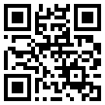
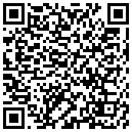
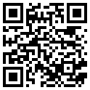
Thank You & Questions
Email
Dr. Ranak Trivedi
Follow Dr. Ranak Trivedi on Twitter
Framily & Mental
Health Lab Website
ranakt@stanford.edu
@RanakTrivedi
https://framilyveteranhealth.stanford.edu

